Slide 1
Congruent triangles (RHS)
Task A: Finding the right angle
1) Using a pair of compasses, find and mark the location of vertex C, which makes the minimum length of BC.
a)
b)
A
c)
B
A
C
C
C
A
B
B
2) Use a protractor to measure angle BCA on each of the diagrams from question 1. What do you notice?
They are all 90°
Task B: Justifying congruence by RHS
1) Use RHS to prove the following pairs of triangles are congruent.
a)
C
K
35 cm
12 cm
120 mm
0.35 m
A
B
L
M
∠ABC = ∠KLM = 90°
AC and KM are each triangle’s hypotenuse and are equal as 35 cm = 0.35 m
CB = KL as 12 cm = 120 mm, So. triangle ABC and KLM are congruent by RHS.

Slide 2
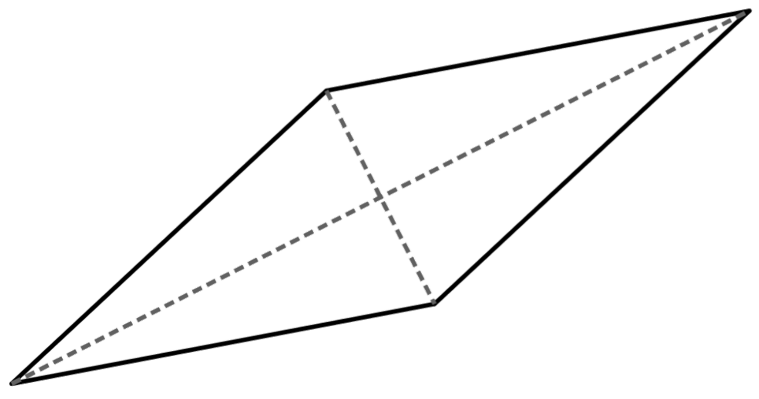
Congruent triangles (RHS)
b)
F
9 cm
O
D
M
37°
12 cm
9 cm
15 cm
15 cm
53°
E
N
∠MON = 180 - (37 +53) = 90° = ∠EDF
EF and MN are each triangle’s hypotenuse and are equal
DE = MO. so, triangle DEF and MNO are congruent by RHS.
2) Triangle TUV is isosceles, where TU = TV. TW is perpendicular to UV.
Prove triangles TUW and TWV are congruent by RHS.
T
∠TWU = ∠TWV as TW is perpendicular to UV.
TU = TV as triangle TUV is isosceles.
TW is a common side to both triangle TUW and TWV. so, triangles TUW and TWV are congruent by RHS.
U
W
V
3) By using known facts about rhombi and their diagonals prove that triangle AED is congruent to BEC by RHS.
D
∠AED = ∠BEC = 90° as the diagonals of a rhombus are perpendicular.
A
AD = BC as they are edges of a rhombus.
E
AE = EC as the diagonals of a rhombus bisect each other. So, triangle AED and BEC are congruent by RHS.
C
B
Mathematics in Education and Industry.
v2.3

